Slide 1

Problem Solving using Python
Packages & Modules
By: Dr Aditya Saxena

Slide 2
Packages and Modules
In Python, both modules and packages organize and structure the code.
In simple terms, a Module is a single file containing python code, whereas
a Package is a collection of modules that are organized in a directory hierarchy.

Slide 3
Modules
A module is a single file containing Python definitions and statements.
These definitions and statements can include variables, functions, and classes and can be used to organize related functionality into a single, reusable package.
Modules can be imported and used in other Python files using the import statement.
Some popular inbuilt modules in Python are math, random, csv, and datetime.

Slide 4
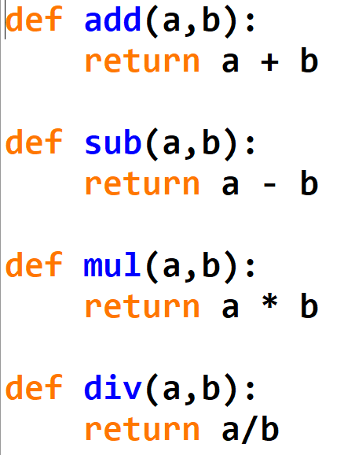
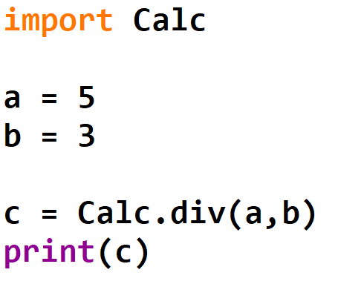
Module Example:
demo.py
Calc.py

Slide 5
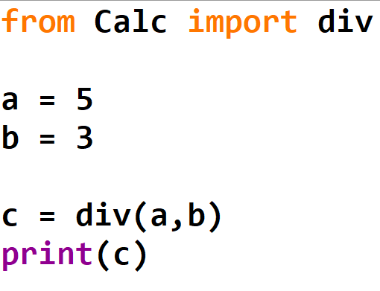
Module Example:
demo.py
Calc.py

Slide 6
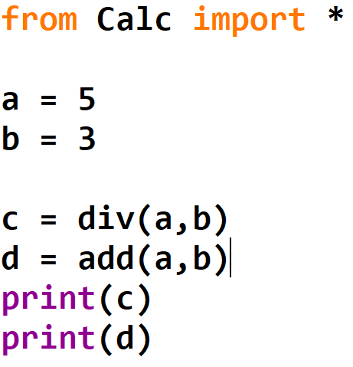
Module Example:
demo.py
Calc.py

Slide 7
Packages (folder/directory)
Python Packages are collections of modules that provide a set of related functionalities, and these modules are organized in a directory hierarchy.
In simple terms, packages in Python are a way of organizing related modules.
Each Python package must contain a file named _init_.py.

Slide 8
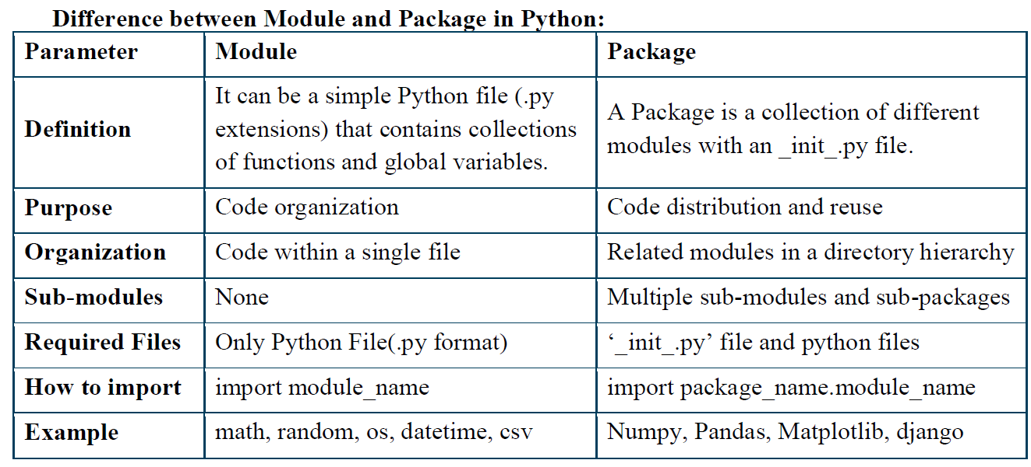

Slide 9
Problem Solving using Python
File Handling
By: Dr Aditya Saxena

Slide 10



File Handling
File is a named location on disk to store related information permanently
New Folder
abc.txt
D:\New folder\abc.txt

Slide 11
Steps in File Handling
Open the file
Perform the read or write operation
Close the file

Slide 12


Step 1. open the file
Before you can read or write a file, you have to open it using Python's built-in open() function.
This function returns a file object
If the file cannot be opened, an Error is raised
File_object = open( file_name , [access_mode] )
A string value that contains the absolute / relative path the file

Slide 13


Step 1. open the file
Before you can read or write a file, you have to open it using Python's built-in open() function.
This function returns a file object
Ifthe file cannot be opened, an Error is raised
File_object = open( file_name, [access_mode] )
the mode in which the file has to be opened, i.e., read, write, append

Slide 14
Access modes of a file
Character | Meaning
'r' | open for reading (default)
'w' | open for writing, truncating the file first
'a' | open for writing, appending to the end of the file- if it exists
'+' | open for updating (reading andwriting)

Slide 15
To open a file
# open file in current directory
>>> f =open("test.txt")
Relative Path
Absolute Path
# specifying full path
>>> f = open("C:/Python3/README.txt")

Slide 16
Step 2. Writing in Files
write()
The write() method writes any string to an open file.
returns the number of characters written.
Syntax
fileObj.write(string)
string to be written into the opened file

Slide 17
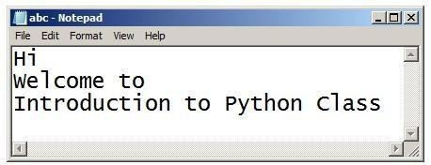


write()
>>>a=open("abc.txt","w")
>>>a.write("""Hi \nWelcome to
Introduction to Python Class""")
43
>>>a.close()
abc.txt

Slide 18
Reading from files
read()
Syntax
returns the read string
>>>fileObj.read([count])
the number of bytes to be read / if not given then reads the complete file
starts reading from the beginning of the file

Slide 19

Reading from files
>>>a=open("abc.txt","r")
>>>a.read(10)
'Hi\ nWelcome‘
>>>a.close()

Slide 20
Reading from files
>>>a=open("abc.txt","r")
>>>a.read() ## return string
'Hi\nWelcome to\nIntroduction to Python Class‘
>>>a.close()
<Subject Code> <Name of Subject>
38

Slide 21
Reading from files
readlines()
read all the lines of a file in a list
>>>a=open("abc.txt","r")
>>>a.readlines() ## return list of string
['Hi\n', 'Welcome to\n', 'Introduction to Python Class']
>>>a.close()

Slide 22
Reading from files
We can read a file line-by-line using a for loop.
This is both efficient and fast.
>>>a=open("abc.txt","r")
>>>for line in a:
print(line)
Hi
Welcome to
Introduction to PythonClass
Two new lines - one due to actual line-break and another due to print function

Slide 23
Reading from files
readline()
read one line each time from the file, including the newline character.
>>>a = open("abc.txt","r")
>>>a.readline()
'Hi\n‘
>>>a.readline()
'Welcome to\n‘
>>>a.readline()
'Introduction to PythonClass‘
>>>a.readline()
‘’
>>>a.close()

Slide 24
Step 3. Closing the file
It flushes any unwritten information and closes the file object, after which no more writingcan be done.
Python automatically closes a file when the reference object of a file is reassigned to anotherfile.
It is a good practice to use the close() method to close a file.
>>>fileObject.close()

Slide 25
What is regular expression?
The term "regular expression", sometimes also called regex
Regular Expressions are used in programming languages to filter texts or strings.
It's possible to check - if a text or a string matches a regular expression.

Slide 26
Problem Solving using Python
Regular Expressions
By: Dr Aditya Saxena

Slide 27
In Python, we have module “re” that helps with regular expressions.
So you need to import library re before you can use regular expressions in Python.
import re

Slide 28
What are various methods of Regular Expressions?
The ‘re’ package provides multiple methods to perform queries on an input string.
re.match()
re.search()
re.findall()

Slide 29
re.match(pattern, string):
The match() method will only find matches if they occur at the start of the string being searched.
For example, calling match() on the string ‘AV Analytics AV’ and looking for a pattern ‘AV’ will match.
However, if we look for only Analytics, the pattern will not match.
Code
>>> import re
>>> result = re.match(r'AV', 'AV Analytics Vidhya AV')
>>> result
<re.Match object; span=(0, 2), match='AV'>
>>> result.start()
0
>>> result.end()
2
>>> result.group(0)
'AV'

Slide 30
re.search(pattern, string)
It is similar to match() but it doesn’t restrict us to find matches at the beginning of the string only.
Unlike previous method, here searching for pattern ‘Analytics’ will return a match.
Code
result = re.search(r'Analytics', 'AV Analytics Vidhya AV')
print (result.group(0))
Output: Analytics
Here you can see that, search() method is able to find a pattern from any position of the string but it only returns the first occurrence of the search pattern.

Slide 31
re.findall (pattern, string):
It helps to get a list of all matching patterns.
It has no constraints of searching from start or end.
If we will use method findall to search ‘AV’ in given string it will return both occurrence of AV.
re.findall() it can work like re.search() and re.match() both.
result = re.findall('AV', 'AV Analytics Vidhya AV')
print (result)
Output: ['AV', 'AV']

Slide 32
re.compile(pattern, repl, string)
We can combine a regular expression pattern into pattern objects, which can be used for pattern matching.
It also helps to search a pattern again without rewriting it.
Code
pattern=re.compile('AV')
result=pattern.findall('AV Analytics Vidhya AV')
print (result)
['AV', 'AV']
result2=pattern.findall('AV is largest analytics community of India')
print (result2)
['AV']

Slide 33
Regular expressions use two types of characters:
Meta characters: these characters have a special meaning, Ex. . ^ $ * + ? { } [ ] \ | ( )
Literals: have usual meaning
Ex. A, B, a,b,text,1,2…….

Slide 34
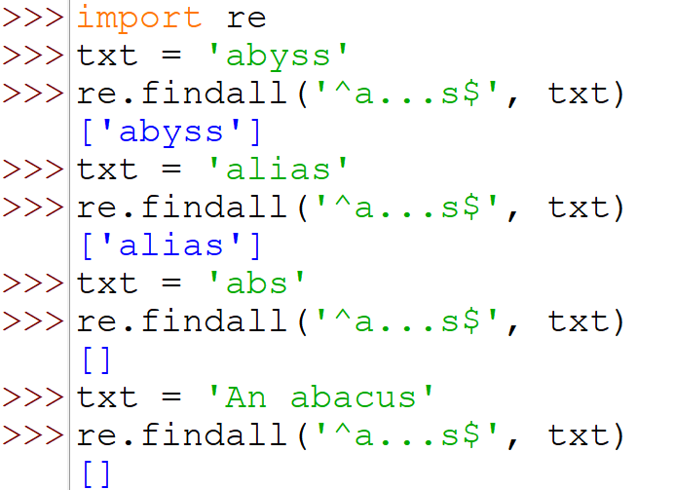
The following special-character sequences are recognized in regular expression patterns:
.
^
$
Description
Matches any character except newline.
Matches the start of a string.
Matches the end of a string.
Character

Slide 35
The following special-character sequences are recognized in regular expression patterns:
Character
Description
Matches zero or more repetitions of the preceding (before) expression, matching as many repetitions as possible.
Matches one or more repetitions of the preceding expression, matching as many repetitions as possible.
*
+

Slide 36
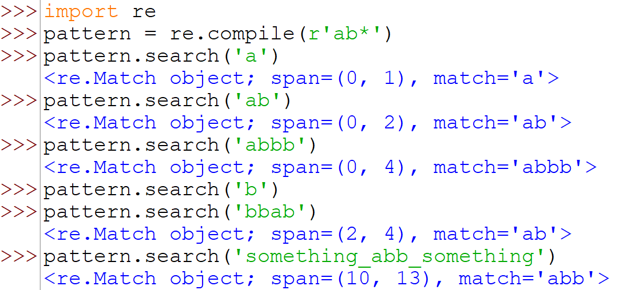
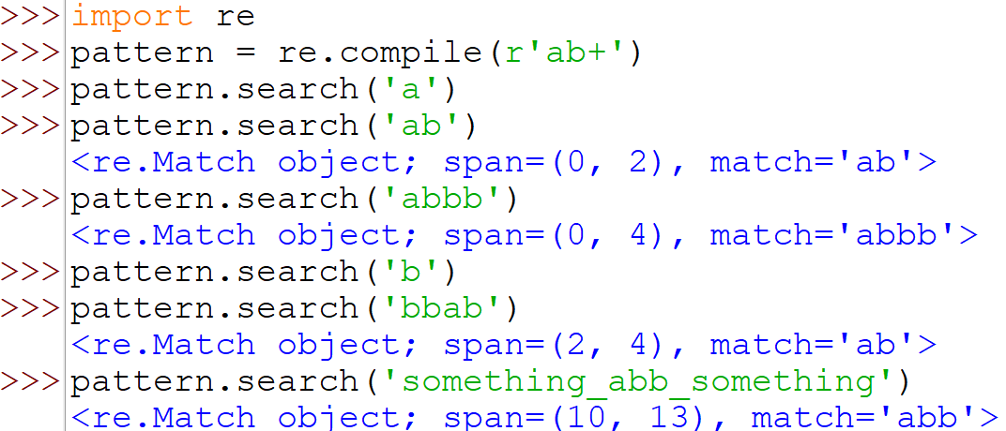
Difference between * and +
* Matches zero or more repetitions of the preceding (before) expression, matching as many repetitions as possible.
+ Matches one or more repetitions of the preceding expression, matching as many repetitions as possible.
raw

Slide 37
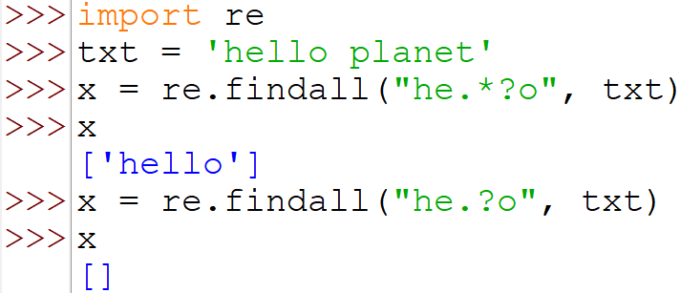
*? Matches zero or more repetitions of the preceding expression, matching as few repetitions as possible.
? Matches zero or one repetition of the preceding expression.
neither 0 nor 1 repetitions so no match

Slide 38
Predefined Character Classes
\d Matches any decimal digit; equivalent to the set [0-9].
\D The complement of \d. It matches any non-digit character; equivalent to the set [^0-9].
\w Matches any alphanumeric character; equivalent to [a-zA-Z0-9_].
\W Matches the complement of \w.

Slide 39
[ ] - Square brackets
Square brackets specifies a set of characters we wish to match.
Expression | String | Matched ?
[abc] | a | 1 match
 | ac | 2 matches
 | Hey Jude | No match
 | abc de ca | 5 matches
Here, [abc] will match if the string we are trying to match contains any of the a, b or c.

Slide 40
We can also specify a range of characters using - inside square brackets.
[a-e] is the same as [abcde].
[1-4] is the same as [1234].
[0-39] is the same as [01239].
We can complement (invert) the character set by using caret ^ symbol at the start of a square-bracket.
[^abc] means any character except a or b or c.
[^0-9] means any non-digit character.

Slide 41
Problem: Validate a phone number (phone number must be
of 10 digits and starts with 8 or 9)
We have a list phone numbers in list “li” and here we will validate phone numbers using regular
Solution
import re
li=['9999999999','999999-999','99999x9999']
for val in li:
if re.match(r'[8-9]{1}[0-9]{9}',val) and len(val) == 10:
print ('yes' )
else:
print (‘No' )

